Slide 1

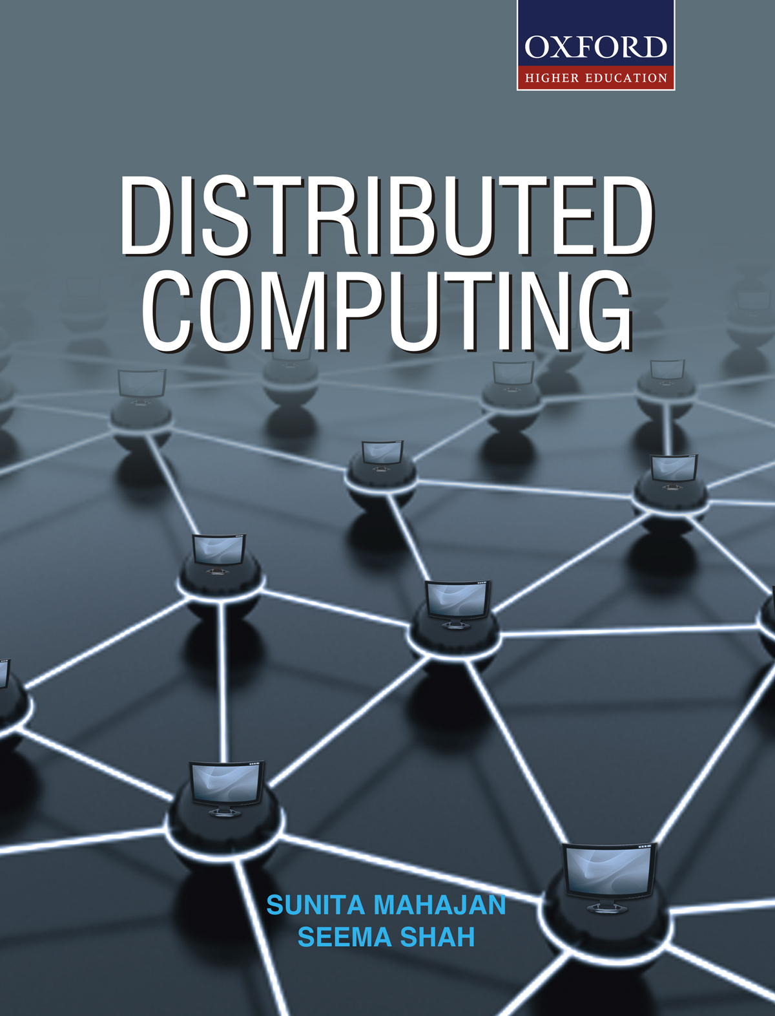
DISTRIBUTED COMPUTING
Sunita Mahajan, Principal, Institute of Computer Science, MET League of Colleges, Mumbai
Seema Shah, Principal, Vidyalankar Institute of Technology, Mumbai University

Slide 2
Chapter - 11
Real-Time Distributed Operating Systems

Slide 3
Topics
Introduction
Design issues in real-time O.S.
Real-time communications
Real-time scheduling
Case study: Real-time communication in MARS

Slide 4
Introduction

Slide 5
Introduction
Basic concepts –
Real means system reacts to external stimuli during their evolution in real time
Correctness of system depends on the time at which the results are produced
Some Real-time applications are:
  Computers embedded in Aircrafts, vehicles, weapons etc.
  Air-traffic control systems, scientific systems, control systems

Slide 6
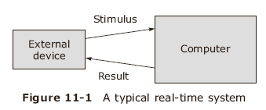
Steps followed in a real-time system
- external sensor sends a stimulus to the computer
-computer performs the actions before a deadline
-then computer sends results through external device
-if computer is idle, it waits for external stimulus

Slide 7
Types of stimuli
Periodic stimuli occur at regular times
  Example is computerized road traffic system
Aperiodic stimuli are recurrent but not regular
  Air traffic control system
Sporadic stimuli are unexpected in nature
  Device overheating, sudden power shutdown
Most real-time systems have a variety of stimuli requiring specific set of actions which have to be completed before the deadline

Slide 8
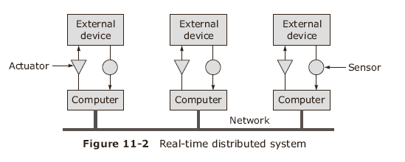
A Real-time distributed System
A real-time system consists of a collection of interconnected computers which receive inputs from external devices through sensors, process them and use actuators to send responses from the computer to external device

Slide 9
Classification of Real-time systems
Soft real-time systems
  A soft real-time system is allowed to miss a n occasional deadline , like a mobile telephone switch may miss a call
Hard real-time systems
  A hard real-time system cannot miss a single stimulus, like in air traffic control system, if the ground controller misses a single request from an airplane, it may lead to an accident

Slide 10
Design Issues in Real-time O.S.

Slide 11
Design Issues
Clock synchronization
  all clocks must be synchronized
Event triggered systems
  External event causes the CPU to take action
    Systems fail if overloaded by event showers
Time triggered systems
  Sensors are sampled at every clock interrupt and required actuators are sent a response from the computer
    System is never overloaded and all deadlines are met

Slide 12
Design issues cont
Fault tolerance
  Controls safety-critical devices in hospitals, vehicles, power plants etc
  One solution is to use active replication
  Second one is to use a primary backup
  Third one is to use a master-slave type approach
  Some systems may halt in case of serious failures and provide for gradual recovery
    Failsafe procedure

Slide 13
Design issues cont
Predictability
  The system should meet all the deadlines even at peak load
  A real-time system should be deterministic
  It should run even in worst conditions
Language support

Slide 14
Real-Time Communications

Slide 15
Real-Time Communications
In real-time distributed systems, predictability is necessary
LAN protocols like Ethernet do not give upper limit to transmission so are unacceptable
Token ring LAN is more suitable
TDMA ( Time Division Multiple Access )is another method for real-time communications

Slide 16
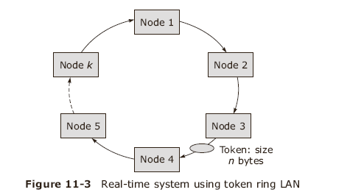
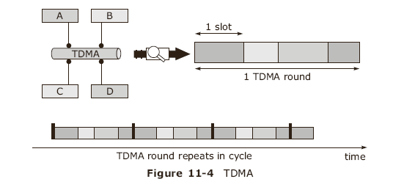
Token ring and TDMA
When a node wishes to send a packet, it captures the token, sends the packet and on completion, puts the token back in circulation
in TDMA, packets are transmitted in fixed frames with each frame having n slots. A processor is given one slot in every frame and allowed to transmit only in the specified slot

Slide 17
Real-time communications in WAN
Real-time connection is set up using connection-oriented technique
Connection is established by negotiating quality of service in advance
  Maximum delay
  Variance if packet delivery time
  Minimum bandwidth
User is charged for the time connection was maintained

Slide 18
Real-Time Scheduling

Slide 19
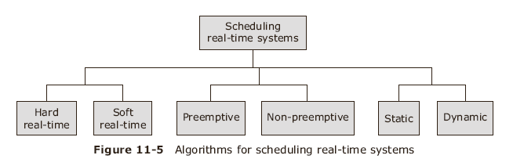
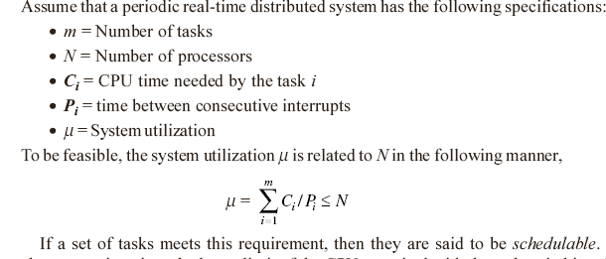
Real-Time Scheduling

Slide 20
Dynamic scheduling
Scheduling is done during program execution
Rate monotonic algorithm
  Designed for preemptive scheduling periodic tasks with no ordering or mutual constraints, each task having a pre-assigned priority
The earliest deadline first
  a preemptive algorithm having a list of waiting tasks sorted by deadline
The laxity algorithm
  A list of tasks with lax time available and choosing task with least lax time

Slide 21
Static scheduling
Scheduling done before the program execution starts
Maintains a list of tasks with their execution time and does static scheduling by finding optimum algorithm

Slide 22
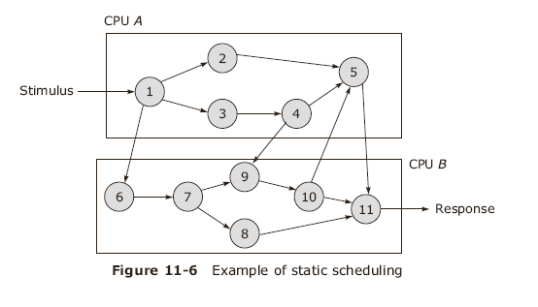
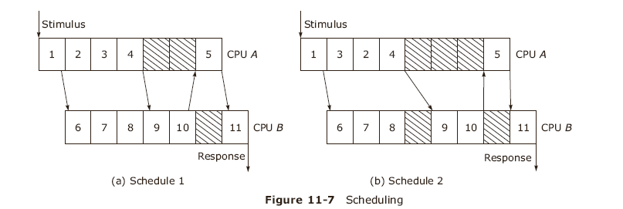
Example of Static Scheduling
CPUs A and B run local and remote interdependent tasks

Slide 23
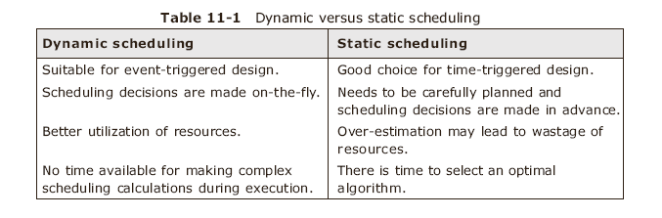
Comparison of dynamic and static scheduling

Slide 24
Case study: MARS system

Slide 25
Case study: MARS system
Real-time communication
MARS system uses TTP protocol
A node has 2-3 CPUs to give a single fault-tolerant fail-safe image
All clocks are continuously synchronized by hardware
MARS nodes are interconnected using two reliable and independent TDMA broadcast networks
TTP is a single-layer protocol handling end-to-end data transport, clock synchronization and membership management

Slide 26
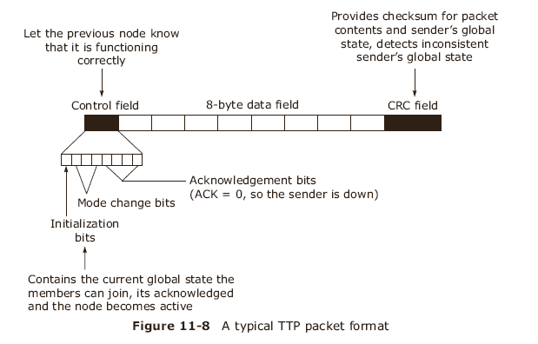
TTP

Slide 27
Summary
Design issues in real-time O.S.
Real-time communications
Real-time scheduling
Case study: Real-time communication in MARS

